Slide 1
AI Adaptation in Game Design
Melody Chirinos

Slide 2
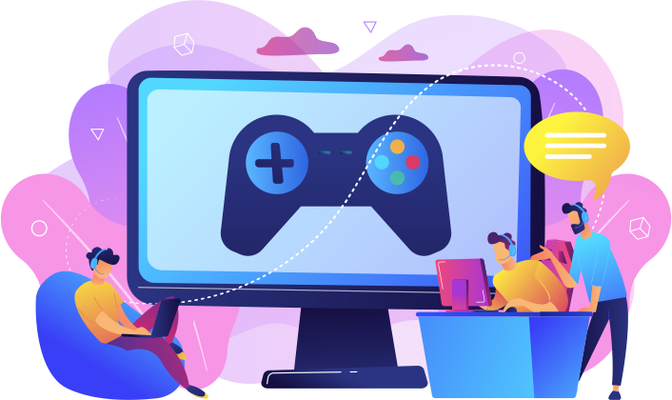
What is AI Adaptation in Game Design?
This refers to the use of AI techniques in collaboration with human developers to create more creative and dynamic games
Currently there are 4 main types of AI used in Game Design
Reactive AI
Rule-based AI
Scripted AI
Learning AI

Slide 3
How does AI make game design better?
Different types of AI have certain pros and cons
Pros:
Can adjusts game difficulty
Can provide hints
Can help create several (unique) endings
Cons:
Can be expensive to implement
Can be complex to implement
Overall I believe the cons are a way to a means and can be easily overlooked to turn a profit if done correctly.

Slide 4
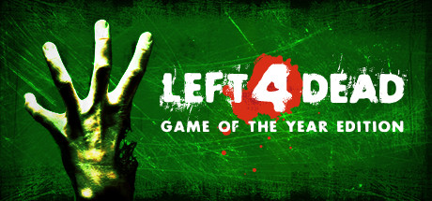
Reactive AI
Left 4 Dead (2008)
Reactive AI:
It reacts to player behavior to adjust the pace, difficulty, and tension of the game
How it used:
If players progress too quickly more infected will spawn in and vice versa

Slide 5
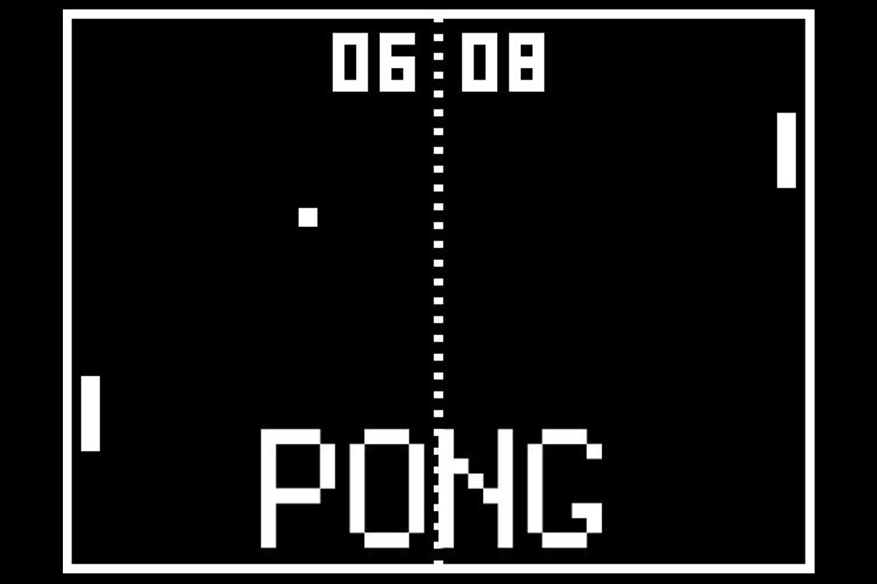
Rule-Based AI
Pong (1972)
Rule-Based AI:
It reacts to the players action with predefined rules
How it used:
The computer’s paddle is pre-programmed to react to the ball’s position and speed
Ex: if the ball moves up the paddle will too

Slide 6
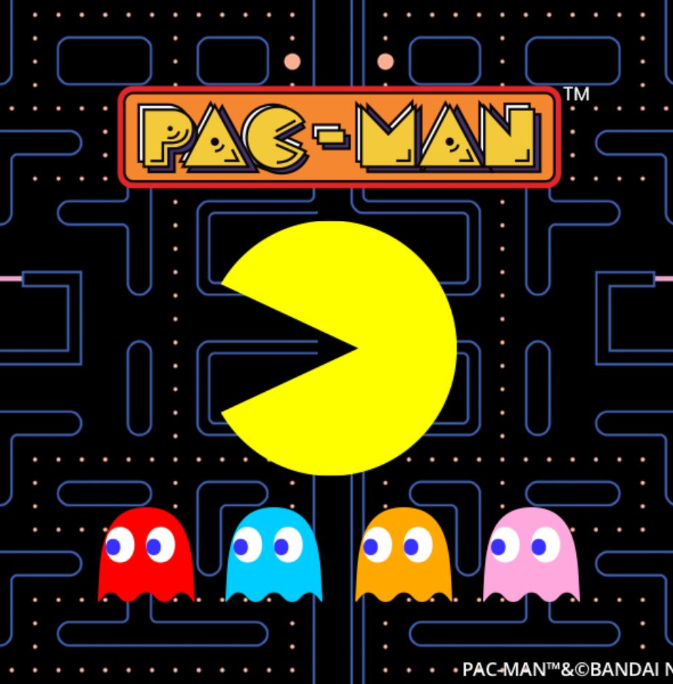
Scripted AI
Pac-Man (1980)
Scripted AI:
Uses pre-programed code
How it used:
The ghosts movement is pre-programmed in the game and does not directly change due to the player
Blinky: Chases pac-man directly
Inky: Calculates based on Blinky and Pac-man
Clyde: Chases pac-man directly but with a scatter pattern of 8 dots
Pinky: 2 tiles in front of pac-man

Slide 7
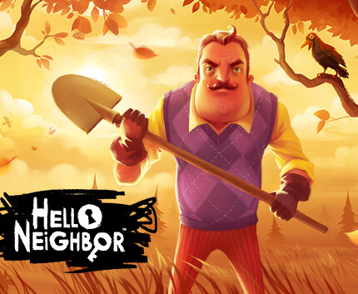
Learning AI
Hello Neighbor (2017)
Learning AI:
A more advanced type of AI that adapts to the player’s behavior over time and learn from it
How it used:
If the player uses the same manner to break in, the Neighbor(AI) will block off that entrance
If the player uses the same distraction method, the Neighbor will ignore it
Notes:
Hello neighbor blew up upon its initial release because of its unique AI

Slide 8

In Conclusion
AI can makes games more enjoyable by providing a more unique user experience through:
Environment interaction
NPC’s interaction
Different outcomes
Although it is costly, if used correctly it will definitely help turn over a profit

Slide 9

Questions?

Slide 10
Sources
Mamiit, Aaron. “Stealth Horror Game 'Hello Neighbor' Features AI That Will Learn from the Player's Actions.” Tech Times, 1 Oct. 2016, https://www.techtimes.com/articles/180268/20160930/stealth-horror-game-hello-neighbor-features-ai-that-will-learn-from-the-players-actions.htm.
Rawat, Akash. “Pong Game Using AI - Ijsrp.org.” Pong Game Using AI, 26 Sept. 2022, https://www.ijsrp.org/research-paper-0922/ijsrp-p12939.pdf.
Thompson, Tommy. “In the Directors Chair: The AI of Left 4 Dead.” Medium, Medium, 19 Sept. 2017, https://medium.com/@t2thompson/in-the-directors-chair-the-ai-of-left-4-dead-78f0d4fbf86a.
“Understanding Pac-Man Ghost Behavior.” GameInternals, 2 Dec. 2010, https://gameinternals.com/understanding-pac-man-ghost-behavior.

